Slide 1
JAVA PRESENTATION 1
Presentor: Nguyen Lam Hoang Anh

Slide 2
CONTENTS
OOP
DESIGN PATTERN
CONCLUSION

Slide 3
OOP
Group related variables and methods into a unit called object
Solving problems by using objects to interact with each other

Slide 4
OOP
1
2
3
4
Encapsulation
Polymorphism
Inheritance
Abstaction

Slide 5
Encapsulation
Combine related functions and variables into a object
Only allow users to interact with object's properties through get and set methods
Notes:
group related variables and functions that operate on them into objects
Hide data from user. Users can not interact directly with object's property, but they have to do that through the methods that we have provided

Slide 6
Abstraction
Only show needed methods
Hide detail implementations

Slide 7
Inheritance
A class can inherit the properties and methods of another class
Eliminate redundant code

Slide 8
Polymorphism
Define more than one way to do something
Same method will behave differently depend on the type of the object

Slide 9
Non - functional requirements
User interface need to be simple and easy to use
Extensibility.

Slide 10
SYSTEM SPECIFICATION
1
2
3
4
5
Technologies
System architecture
Database design
Features
Laravel concepts

Slide 11
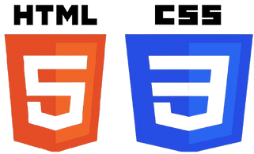




Technologies
Front-end
Back-end

Slide 12
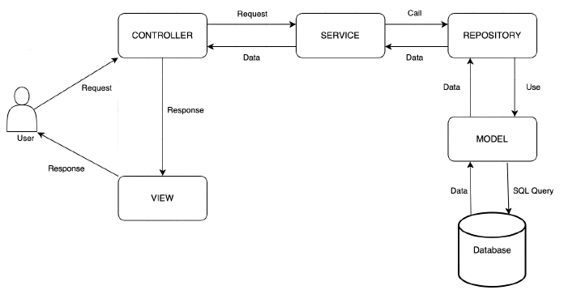
System architecture
Service layer: handling bussiness logic
Repository layer: using model to interact with database

Slide 13
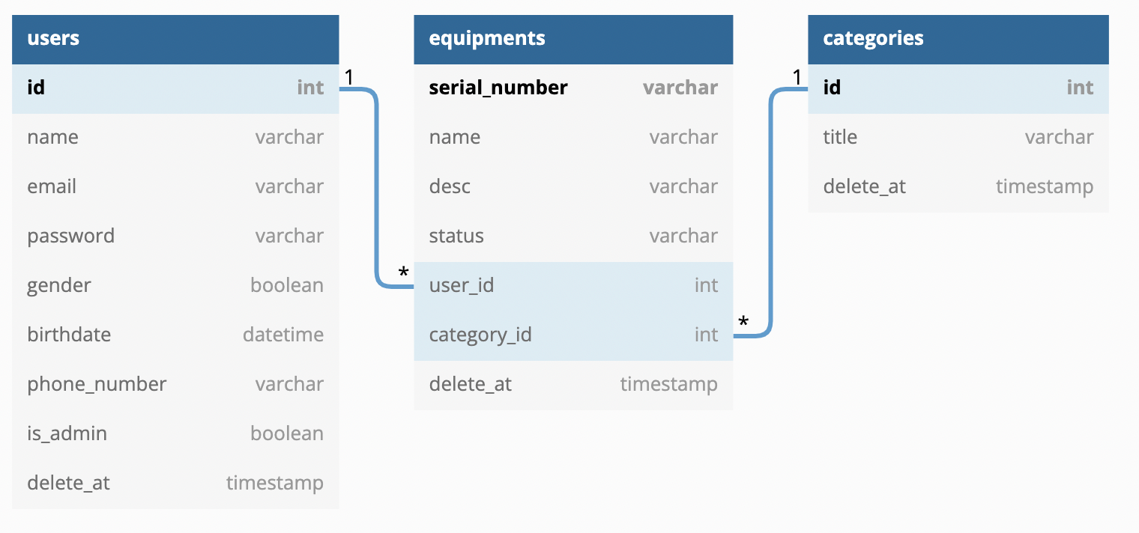
Database design

Slide 14
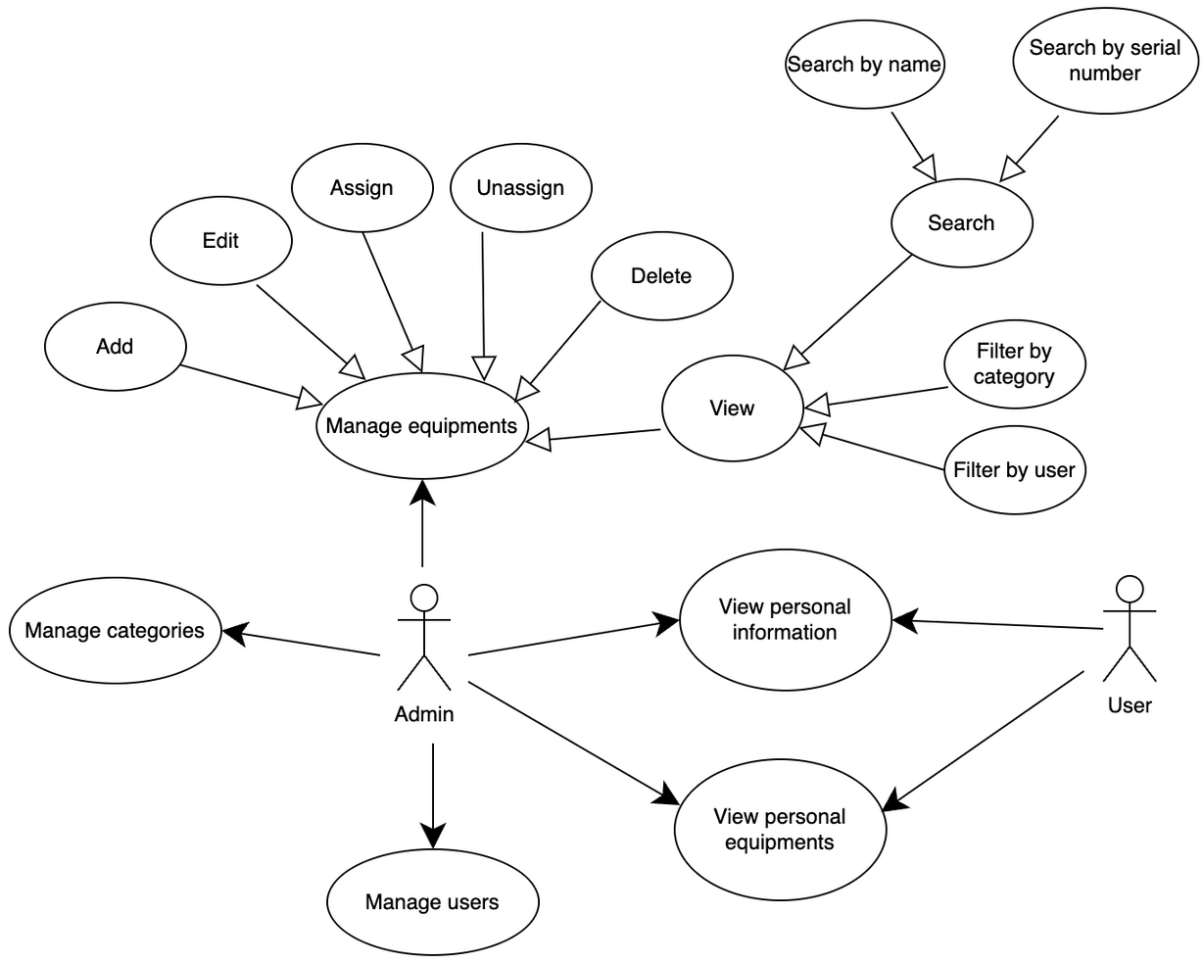
Features

Slide 15
Laravel concepts
Routing: Web route, API route
Controller
Eloquent ORM
Migration
Middleware
JWT (JSON web token)
Eloquent resources

Slide 16
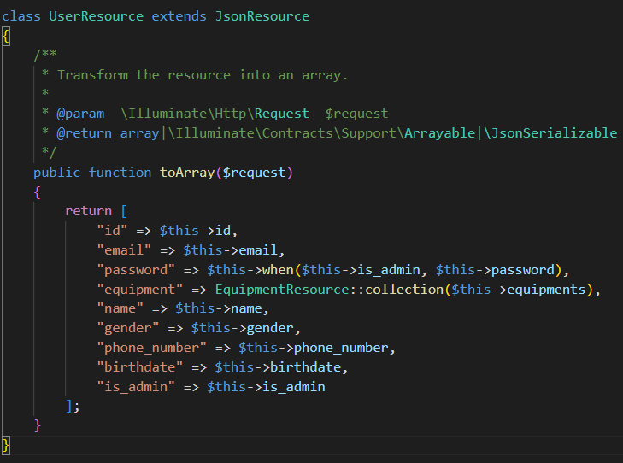
Eloquent resource
UserResource class

Slide 17
DEMO

Slide 18
OVERVIEW
1
2
3
Advantages
Disavantages
Future improvements

Slide 19
Advantages
Manage equipments easily with simple user interface.
Listing equipment by user name or id.

Slide 20
Disadvantages
Admin may accidentally press unassigned button.
Normal user can not request for equipments.
User can not update their information.

Slide 21
Future improvements
Implement missing features in disadvantages section.
Add new features for upload equipments images.
Add new features to sort equipments by each attributes.

Slide 22


Slide 23


